Slide 1
Project convex hull from fast preset to slow preset
Project convex hull between different encoders
Stage 1
Stage 1
SHOT DETECTION
PER SHOT ENCODE
CONVEX
HULL
SHOT DETECTION
PER SHOT ENCODE
CONVEX
HULL
Input
Input
x264 fast
CRF 10–48
VP9 speed 3
[28, 33, 38,
43, 48, 51]
For each (R,D):
shot 1: <res₁, QP₁>
:
shot n: <res_{n,} QP_{n}>
For each (R,D):
shot 1: <res₁, QP₁>
:
shot n: <res_{n,} QP_{n}>
Stage 2
PROJECTED CONVEX HULL
Stage 2
PROJECTED CONVEX HULL
PER SHOT ENCODE
PER SHOT ENCODE
x264 veryslow
AV1 speed 0

Slide 2
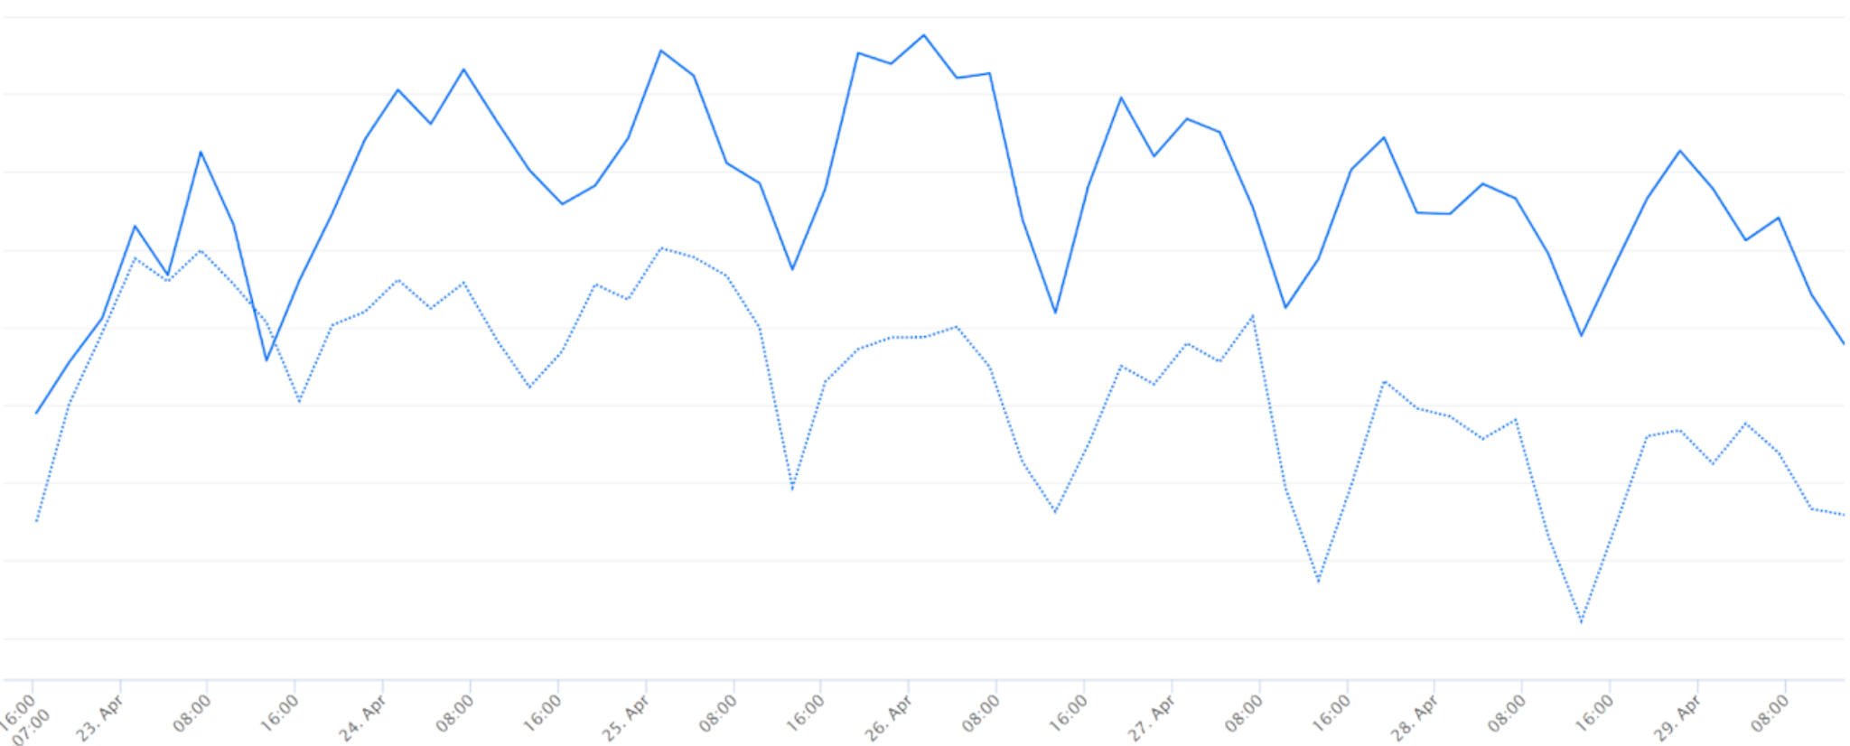

Slide 3
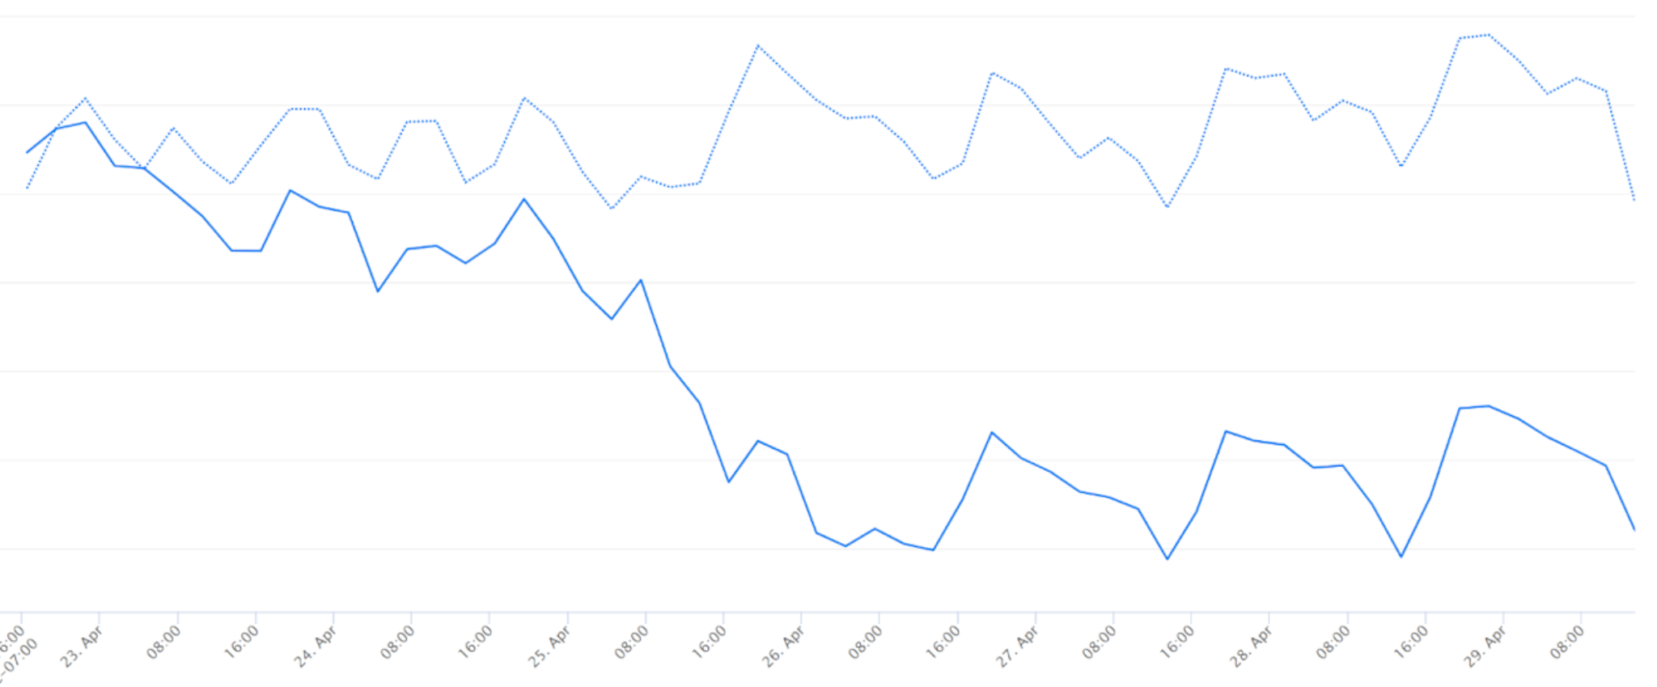

Slide 4
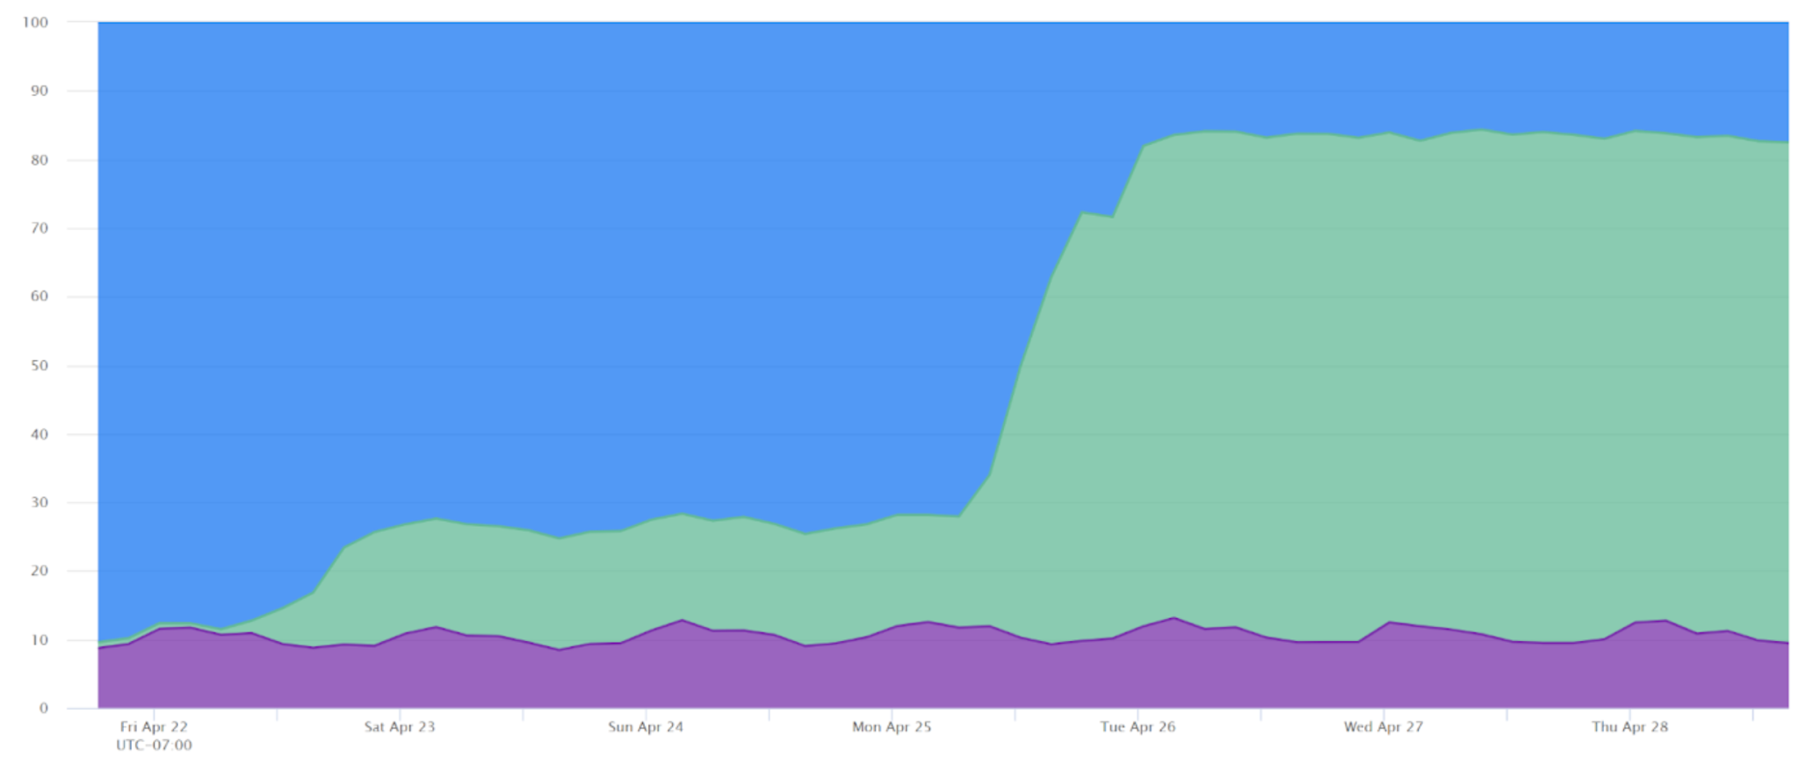

Slide 5
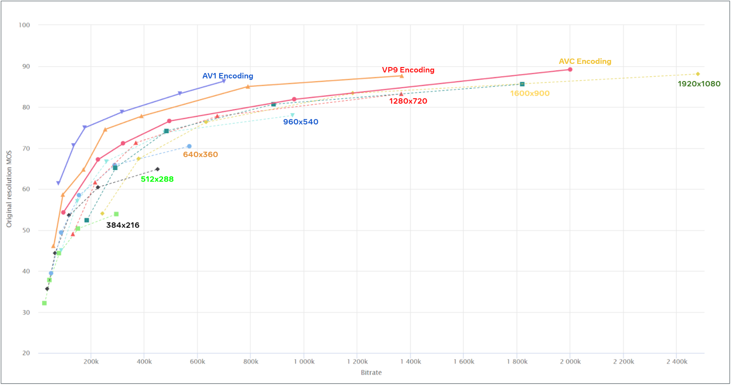
Fewer encoding lanes
48% bitrate saving
Fewer encoding lanes
65% bitrate saving

Slide 6
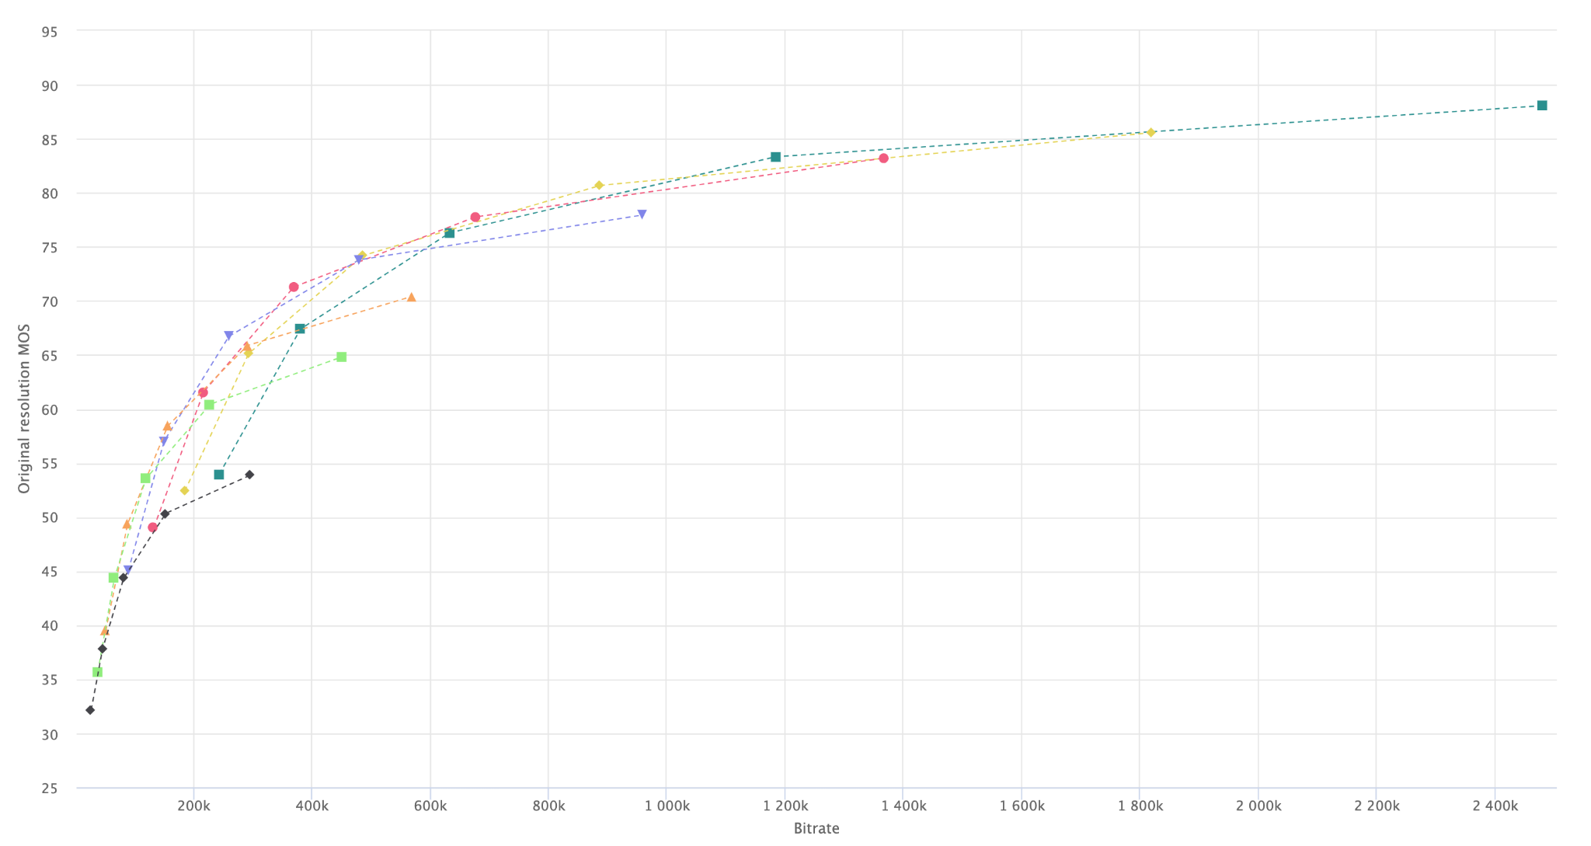
Quality target
Convex hull
1920x1080
1600x900
1280x720
960x540
640x360
512x288
384x216
Bitrate target

Slide 7
Convex hull
1920x1080
1600x900
1280x720
960x540
640x360
512x288
384x216

Slide 8
1920x1080
1600x900
1280x720
960x540
640x360
512x288
384x216

Slide 9
